Slide 1

ReServe
Created by:
Richard Compton (Display)
Mary Shiner (Display)
Kevin Kaminski (Mobile)
Kelly Kurkowski (Mobile)
Selena Haidar (Middleware)
Seth Logan (Middleware)
Elias Qumsieh (Middleware)
Sprint 3!
Notes:
We introduce ourselves.

Slide 2
Richard - Restaurant Configuration
Use Case Name | Restaurant Configuration
Business Event | A restaurant wants to add information to their ReServe account.
Actors | Restaurant administrator
Use Case Overview | Restaurant administrators enter a variety of information about their restaurant that will be viewed by potential guests and used to calculate wait times for reservations.
Preconditions | The restaurant must have an authenticated ReServe account.
Termination Outcome | The restaurant enters the correct information; it is displayed on the ReServe website and application. The restaurant enters the incorrect information; they are asked to fix their mistakes or it will not be published.
Notes:
Mary?

Slide 3
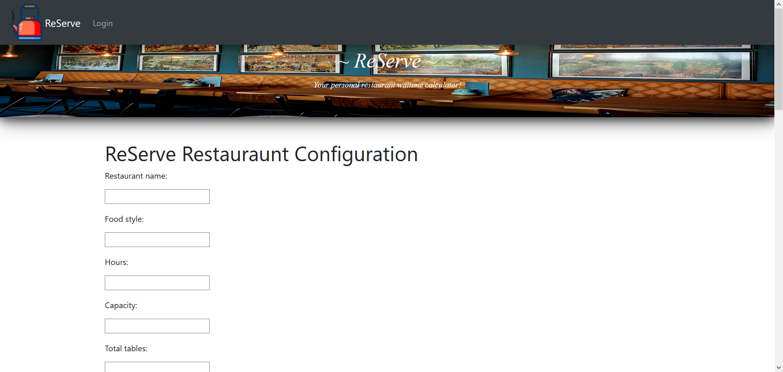
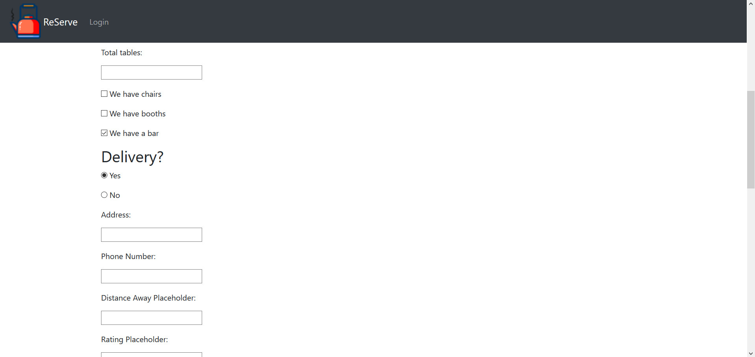
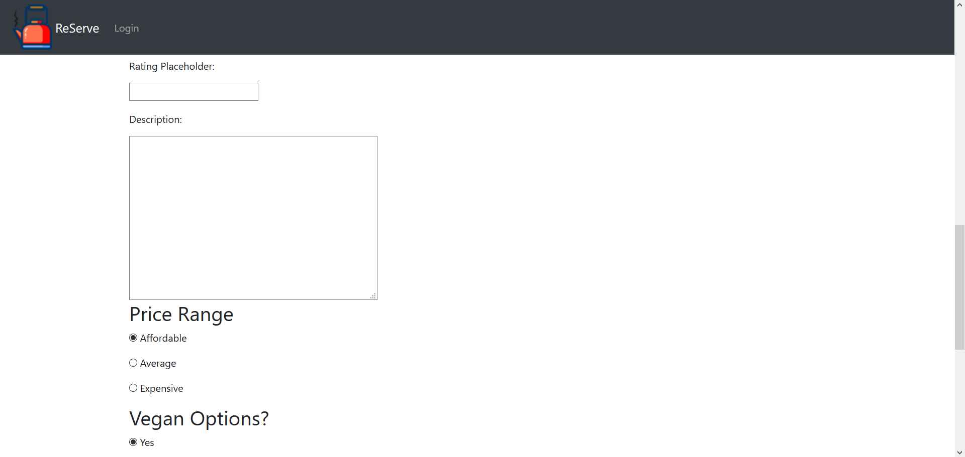
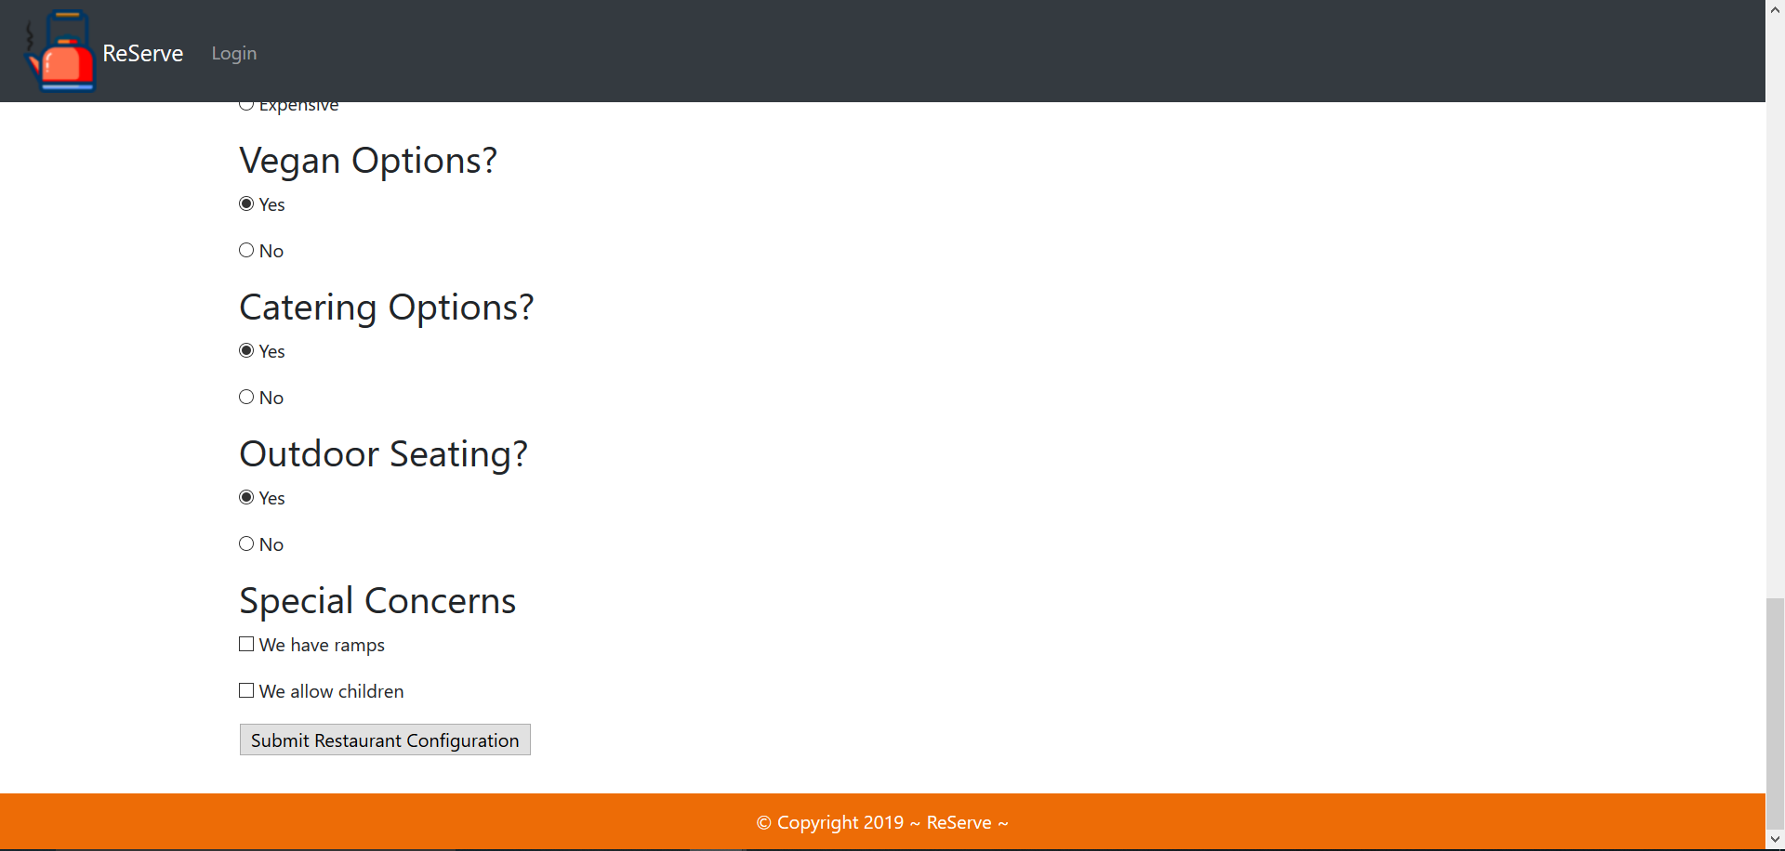
Mary
Notes:
Mary

Slide 4
Mary
Possible Regular Waitimes (Estimated) 1 mins take order + 5 mins food prep + 10 mins food served + 2 cleanup = 18 mins ( 1 person)
2 mins take order + 10 mins food prep + 20 mins food served + 2 cleanup = 34 mins ( 2 people)
3 mins take order + 15 mins food prep + 30 mins food served + 2 cleanup = 50 mins ( 3 people)
4 mins take order + 20 mins food prep + 40 mins food served + 2 cleanup = 66 mins ( 4 people)
Formula = (Y*1) + (Y*5) + (Y*10) + (2) = R/T = W
Tables will be shown according to the size of the group. EX: There is a party of two, any table that can seat at least two occupants is shown.
How many tables = T
Number of people in group = Y
Regular Waitime = R
Final Waitime = W
Additional Factors
Time of Day?
Type of meal?
How many servers?
Notes:
Mary

Slide 5
GUI design & Xamarin
Restaurant Considerations
Layout
Multiple rooms
Capacity tables
Restaurant will have a two role
Administrator
Phone screen
Connecting our mobile with the current running project.
Notes:
Kevin

Slide 6
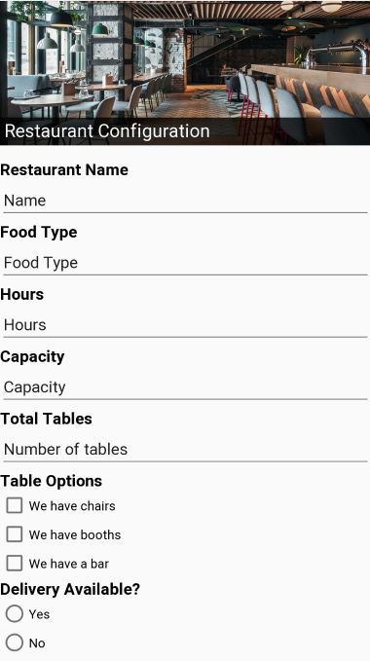
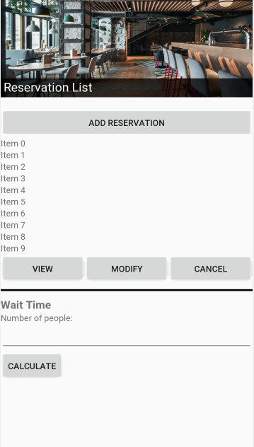
Kelly
GUIs for Restaurant Configuration & Restaurant Host
Notes:
Kelly and her accomplishments for this Sprint:
Finally got everyone access to the server
Created restaurant host webpage
Hardcore struggle getting acquainted with Xamarin and figuring out what the heck to do with it
Created the 2 GUI screens (screenshots on slide)

Slide 7
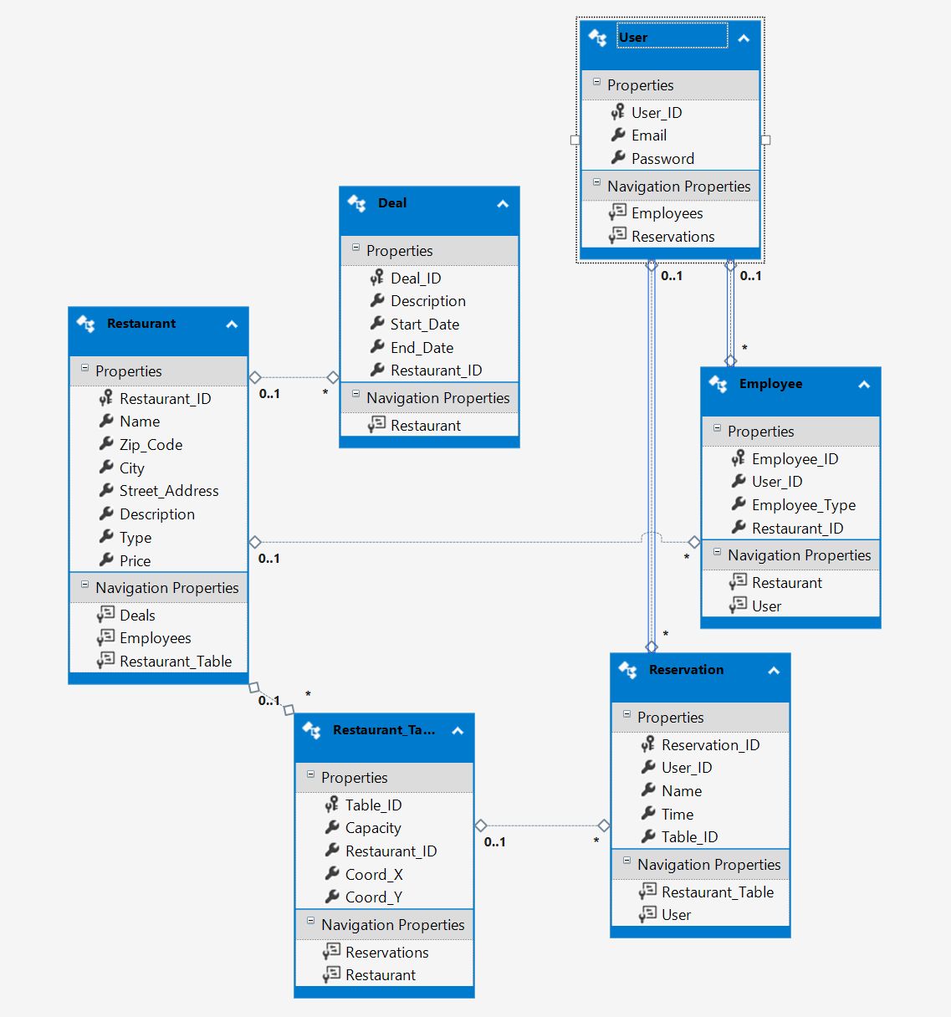

Web API
Setting up database on server and connecting it to ASP.NET Web API

Slide 8
Restaurant Configuration
Converted HTML page to aspx page and implement it with the project
Fetch all the data to insert it in the database
Research of how to insert our data to the server database so it can be accessed any time. We have an issue with our database that happened to the project when merging it into GitHub
Notes:
Elias

Slide 9
Risks and Challenges
Communication
Entity Framework compatibility issues
Bulk of the web API next sprint
Retrieving data on the phone app
Formatting entities

Slide 10
Demo Time
Notes:
Seth + Elias conduct the demo.

Slide 11
Sprint 4 Objectives
As a developer, I want to completely set up our project on our Windows Server so that we can easily access it remotely.
As a restaurant host, I want to implement and interact with my restaurant’s table layout and capacity in a concise, easy-to-use manner.
As a restaurant host, I want to quickly calculate a guest’s current wait time using an accurate algorithm.
As a restaurant host, I want a simple page that allows me to add, cancel, or edit reservations and calculate wait times.
Notes:
Kelly

